Slide 1

Team
Assignment 3

Slide 2
Question
Presents a GQM chart for one assigned Viking project goal:
  Increase project schedule predictability by 10%.
www.themegallery.com

Slide 3
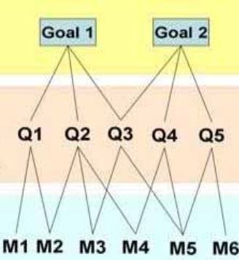
GQM Chart
www.themegallery.com

Slide 4
Perspectives
1. Duration
Question
2. Cost
3. Effort
www.themegallery.com

Slide 5

Question 1.1
What was the accuracy of Matador’s duration estimating?
Metric 1.1:
  Actual duration to finish Matador: A1 (measured by days )
  Estimate duration to finish Matador: E1(measured by days)
  Deviation:
www.themegallery.com

Slide 6

Question 1.2
What was the accuracy of Viking’s duration estimating?
Metric 1.2:
  Actual duration to finish Viking: A2 (measured by days)
  Estimate duration to finish Viking: E2 (measured by days)
  Deviation:
www.themegallery.com

Slide 7
Question 1.3
What was the rate of improvement over the duration estimating of Viking project compare to previous project (Matador)?
Metric 1.3:
  The prediction increases 10% when R1 - R2 >= 10% → Goal accomplished
www.themegallery.com

Slide 8
Perspectives
1. Duration
Question
2. Cost
3. Effort
www.themegallery.com

Slide 9

Question 2.1
What was the accuracy of Matador’s cost estimating?
Metric 2.1:
  Actual cost to finish Matador: A3 (measured by USD)
  Estimate cost to finish Matador: E3(measured by USD)
  Deviation:
www.themegallery.com

Slide 10

Question 2.2
What was the accuracy of Viking’s cost estimating?
Metric 2.2:
  Actual cost to finish Viking: A4 (measured by USD)
  Estimate cost to finish Viking: E4(measured by USD)
  Deviation:
www.themegallery.com

Slide 11
Question 2.3
What was the rate of improvement over the cost estimating of Viking project compare to previous project (Matador)?
Metric 2.3:
  The prediction increases 10% when R3 - R4 >= 10% → Goal accomplished
www.themegallery.com

Slide 12
Perspectives
1. Duration
Question
2. Cost
3. Effort
www.themegallery.com

Slide 13
Question 3.1
What is actual time to do specific task?
Metric 3.1:
  Actual time (measured by hours): Ac
www.themegallery.com

Slide 14

Question 3.2
What was the deviation of estimate time over specific task compare with actual time in the first time?
Metric 3.2:
  Estimate time 1st (measured by hours): Es1
  Deviation (measured by %):
www.themegallery.com

Slide 15

Question 3.3
What was the deviation of estimate time over specific task compare with actual time in the second time?
Metric 3.3:
  Estimate time 2nd (measured by hours): Es2
  Deviation (measured by %):
www.themegallery.com

Slide 16
Question 3.4
What was the improvement estimating effort (compare the second time with the first time)?
Metric 3.4:
  The prediction increases when Dv1 - Dv2 >= 10%
www.themegallery.com

Slide 17
Thank You !
www.themegallery.com

